Slide 1
WPT

Slide 2
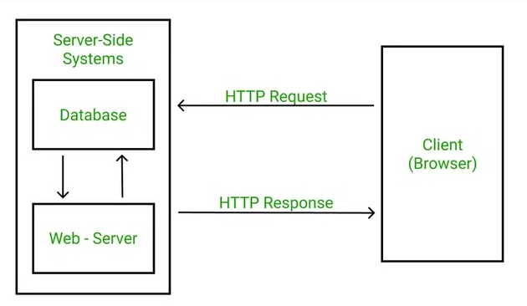
Web Architecture

Slide 3
HTTP stands for Hypertext Transfer Protocol, and it’s the system that allows communication between web browsers (like Google Chrome or Firefox) and websites.
When you visit a website, your browser uses HTTP to send a request to the server hosting that site, and the server sends back the data needed to display the page.
Think of HTTP as a set of rules or a language used by your browser and the web server to talk to each other, ensuring that websites load properly when you type in their URLs.

Slide 4
HTTP : Step-by-Step Process
Open Web Browser: First, you open your web browser and type a website URL (e.g., www.example.com).
DNS Lookup: Your browser asks a Domain Name System (DNS) server to find out the IP address associated with that URL. (looking up the phone number of the website.)
Send HTTP Request: Once the browser has the website’s IP address, it sends an HTTP request to the server. The request asks the server for the resources needed to display the page (like text, images, and videos).
Server Response: The server processes your request and sends back an HTTP response. This response contains the requested resources (like HTML, CSS, JavaScript) needed to load the page.
Rendering the Web Page: Your browser receives the data from the server and displays the webpage on your screen.

Slide 5
What is HyperText?
HyperText is a way of structuring text so that it can contain links (called "hyperlinks") to other documents or resources. When you click on a link in a webpage, you are typically directed to another page or resource on the internet. HTML (HyperText Markup Language) is used to create and format this type of text for web pages.
HTTP is the protocol used to transfer this hypertext between the web browser and the server, allowing you to click links and move around the web.

Slide 6
HTTP Request and Response
An HTTP request is how your browser asks the server for something. It includes:
HTTP Version: The version of HTTP (like HTTP/1.1 or HTTP/2) being used.
URL: The specific address of the resource (e.g., https://www.example.com/about).
HTTP Method: The type of action being requested (e.g., GET to retrieve information or POST to send data).
HTTP Request Headers: Extra information about the request, like what kind of browser you're using or what kind of content you’re expecting.
HTTP Request Body: In some cases, the request will include a body that contains data (e.g., when you submit a form).

Slide 7
HTTP Response
An HTTP response is the server’s answer to your request. It includes:
HTTP Status Code: A number that tells you if the request was successful or not (e.g., 200 OK means everything is fine, 404 Not Found means the requested page doesn’t exist).
Response Headers: Information about the response, like what kind of data is being sent (e.g., Content-Type: text/html means it’s an HTML page).
Response Body: The content that the server sends back (e.g., HTML code that the browser will use to display the webpage).

Slide 8
HTTP Status Code
HTTP Status codes are three-digit numbers that servers use to tell your browser what happened with the request you sent.
Informational (1xx): These codes just give you information
Successful(2xx): These codes tell you everything went fine (e.g., 200 OK means the request was successful).
Redirection(3xx): These codes tell the browser to take additional action (e.g., 301 Moved Permanently means the requested page has moved to a new address).
Client Error (4xx): These codes indicate that there was a problem with your request (e.g., 404 Not Found means the page doesn’t exist).
Server Error (5xx): These codes tell you that something went wrong on the server side (e.g., 500 Internal Server Error means the server had an issue processing the request).

Slide 9
Internet Protocol
HTTP stands for Hypertext Transfer Protocol, and it’s the system that allows communication between web Client (Browser) and Web Server
Communication means Data Exchange
So if you want Data Security we can use HTTPS protocol

Slide 10
HTTPS establishes the communication between the browser and the web server. It uses the Secure Socket Layer (SSL) and Transport Layer Security (TLS) protocol for establishing communication.
HTTPS uses the conventional HTTP protocol and adds a layer of SSL/TLS over it. The workflow of HTTP and HTTPS remains the same
The SSL connection is responsible for the encryption and decryption of the data that is being exchanged to ensure data safety.

Slide 11
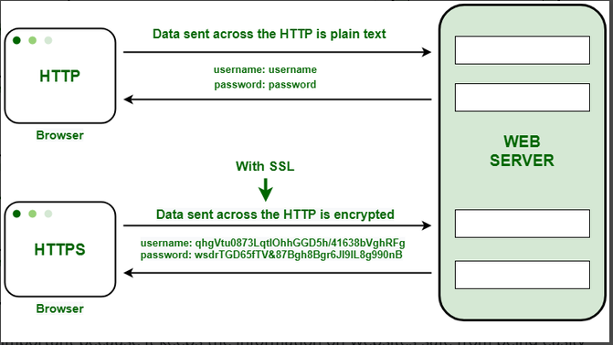

Slide 12
HTTP | HTTPS
HTTP stands for HyperText Transfer Protocol. | HTTPS stands for HyperText Transfer Protocol Secure.
URL begins with “http://”. | URL starts with “https://”.
HTTP Works at the Application Layer. | HTTPS works at Transport Layer.
HTTP speed is faster than HTTPS. | HTTPS speed is slower than HTTP.

Slide 13
What is HTML
HTML stands for Hyper Text Markup Language
HTML is the standard markup language for creating static Web pages
HTML describes the structure of a Web page
which contains elements
HTML elements tell the browser how to display the content

Slide 14
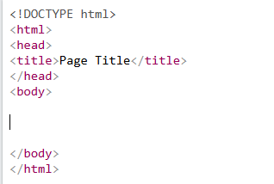

Slide 15
HTML Documents Contains an Elements
Element Contains <Start Tag> Content </End Tag>
Some Elements Are Empty <br>

